Slide 1
Machine learning Project
A competition by kaggle

Slide 2
OUTLINE
Project objective
Data sets and variables
Data processing
Method and analysis
Result
Predicted house prices

Slide 3
Objective
Create an analytical framework to understand key factors impacting house price.
Develop a modeling framework to estimate the price of a house that is up for sale.

Slide 4
Data sets and Variables
Variables:
80 variables present in the dataset
SalePrice - dependent variable it represents final price.
Remaining variables represent different features of the houses.
Kaggle https://www.kaggle.com/c/house-prices-advanced-regression-techniques/overview

Slide 5
Data Processing
Data cleansing -
Treating missing values - continuous variables and character variables.

Slide 6
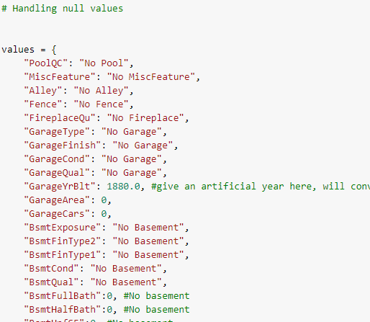
Handling Null-values

Slide 7
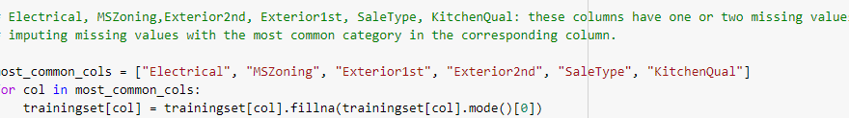
Treating missing values
Contnious variable - missing variables are treated by replacing with mode
Why mode not mean?
Mean is vulnerable to outliers

Slide 8
methodology

Slide 9
Method
T value and probability of t value.
Adjusted R-square
Multi collinearity
Linear Regression

